Slide 1
Release Notes
Release 4.007.000
October 10, 2016

Slide 2
Table of Contents
Enhancement Slide #
Canada 3
Explore Mosaic Chart 4
Info Windows 5
Bookmarks 6
Railroads 7
Manage Locations 8
Internal Tools for AM 11
Bug fixes 12

Slide 3

O Canada!
Description
Canada is now ready for client use and exploration in SCOUT.
How To Use
Very complicated process……go to Canada.
Value
Allows clients to run drive times, explore, run reports with updated data, heatmaps, thematics, etc – basically SCOUT 4 now has full functionality in Canada.

Slide 4
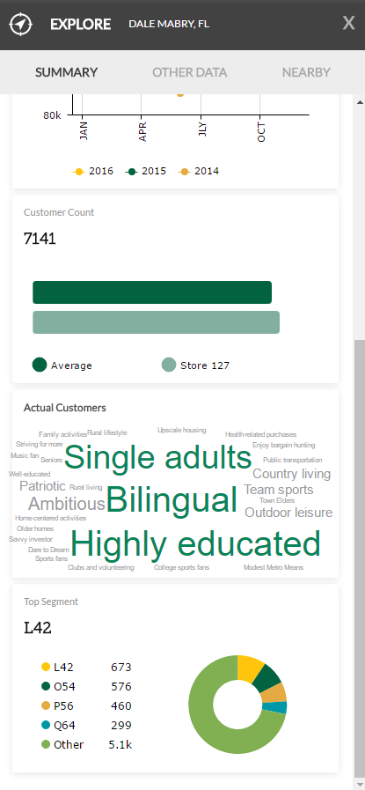
Explore Mosaic chart
Description
The Mosaic chart is back in the Store Explore Window.
How To Use
Same as before – Explore a store.
Value
Explicitly shows their segment breakout and gives them a Word Cloud.

Slide 5
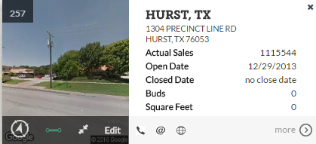
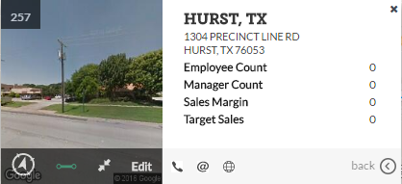
Info Windows – the saga continues…
Description
Info Windows have changed in a few ways….
How To Use
The first “page” of the Info Window now contains the following data points by default: Actual Sales, Open Date, Closed Date, BUDS, Square Feet.
Any 4 “other” columns that they choose to display will show on the second “page”.
Phone, Email, and Website have been moved to the bottom.
Value
More consistent experience while using Info Windows.
Page 1
Page 2

Slide 6


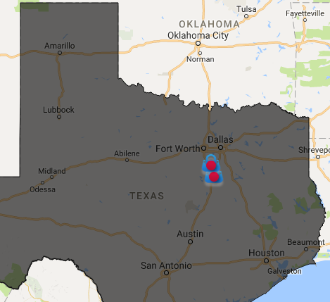
Bookmarks
Description
Results and Areas of Interest (points and geographies) can now be bookmarked.
How To Use
Same as before, turn on desired items, bookmark the view.
Value
Provides a more comprehensive bookmark feature.

Slide 7

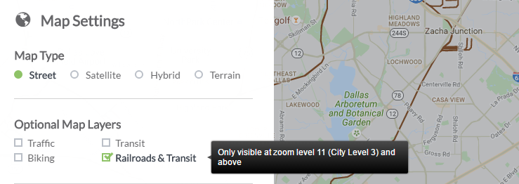
Railroads – new feature!
Description
Railroads are now available in SCOUT.
How To Use
Open Map Settings, check the box for ‘Railroads & Transit’.
Notice that this is only available at certain zoom levels and below (google controlled).
Value
Allows clients interested in railroads to visualize it.

Slide 8

Manage Locations – new feature!
Description
Locations can now be managed in a variety of ways including location and data modifications.
How to use
Move a location – LONG left click, location begins to animate, drag the location to another point on the map.

Slide 9
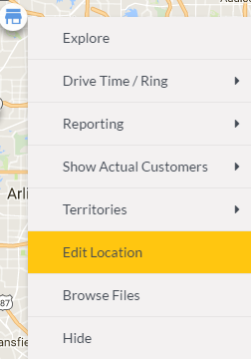
Manage Locations – new feature!
Description
Locations can now be managed in a variety of ways including location and data modifications.
How to use
Edit Location – right click location, choose Edit Location...

Slide 10
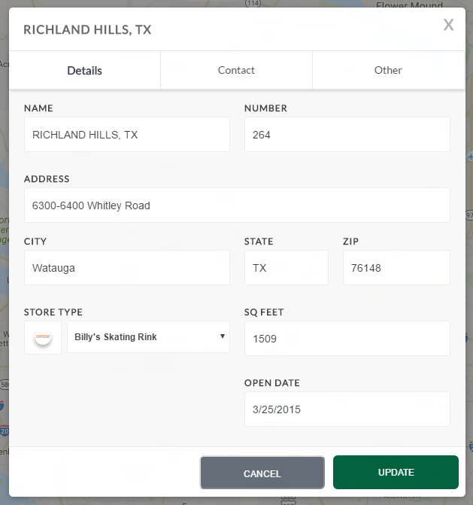
Manage Locations – new feature!
Description
Locations can now be managed in a variety of ways including location and data modifications.
How to use
Inside the dialog, modify various points of information about the store as desired.
When finished, click the green “UPDATE” button.
Value
Allows Clients more control and a more robust experience when working with their stores.

Slide 11
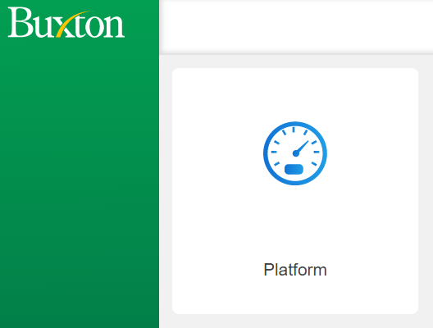
Internal Tools for AM
Description
Internal Tools has been approved for AM access.
How To Use
Get with Gregg, Chris C., or Sean D.
AM has limited access with some needed functionality to assist clients.
Value
Allows AM insight into client platform usage (work in progress).
Allows AM to assist with some client issues without having to rely on other support.

Slide 12

Notable Bug fixes
Fixed
SCOUT – fixed bug pertaining to trying to run a report off a newly created territory.
PLATFORM – logic for “too many devices logged in” is more intelligent (if they are on the same PC using the same browser, and try and log in a second time, it will log their old session out). Max Device Count still applies.

